Slide 1


V1 Update & Q1 Roadmap
The vLLM Meetup
at Google Cloud
The vLLM Team

Slide 2
Agenda
V1 Deep Dive (Woosuk)
vLLM’s Q1 Roadmap (Simon)

Slide 3
vLLM's Goal
Build the fastest and
easiest-to-use open-source
LLM inference & serving engine

Slide 4



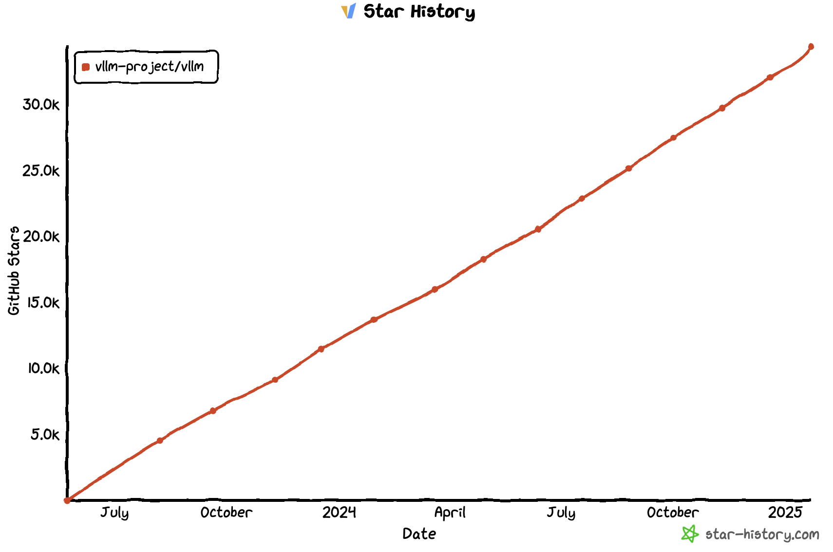
vLLM Today
https://github.com/vllm-project/vllm
$ pip install vllm
34.5K Stars
Official
release!

Slide 5
vLLM API (1): LLM class
A Python interface for offline batched inference
from vllm import LLM
# Example prompts.
prompts = ["Hello, my name is", "The capital of France is"]
# Create an LLM with HF model name.
llm = LLM(model="meta-llama/Meta-Llama-3.1-8B")
# Generate texts from the prompts.
outputs = llm.generate(prompts) # also llm.chat(messages)]

Slide 6
vLLM API (2): OpenAI-compatible server
A FastAPI-based server for online serving
Server
$ vllm serve meta-llama/Meta-Llama-3.1-8B
Client
$ curl http://localhost:8000/v1/completions \
-H "Content-Type: application/json" \
-d '{
"model": "meta-llama/Meta-Llama-3.1-8B",
"prompt": "San Francisco is a",
"max_tokens": 7,
"temperature": 0
}'

Slide 7
vLLM V1
Woosuk Kwon

Slide 8
What is vLLM V1?
Re-architect the “core” of vLLM
based on the lessons from V0 (current version)
Unchanged
Changed
User-level APIs
Models
GPU Kernels
Utility functions
...
Scheduler
Memory Manager
Model Runner
API Server
...

Slide 9
Why vLLM V1?
Main goals:
Simple & easy-to-hack codebase
High performance with near-zero CPU overheads
Combining all key optimizations & enabling them by default

Slide 10
Key changes in vLLM V1
Optimized engine loop & API server
Simplified scheduler
Clean implementation of distributed inference
Piecewise CUDA graphs

Slide 11
Optimized Engine Loop & API Server
Goal: Make sure GPU is not stalled
By pre-processing
E.g., converting JPEG images into input tensors (resizing, cropping, …)
By post-processing
E.g., de-tokenizing output token IDs into output strings
By HTTP request handling
E.g., streaming outputs to 100s of concurrent users

Slide 12
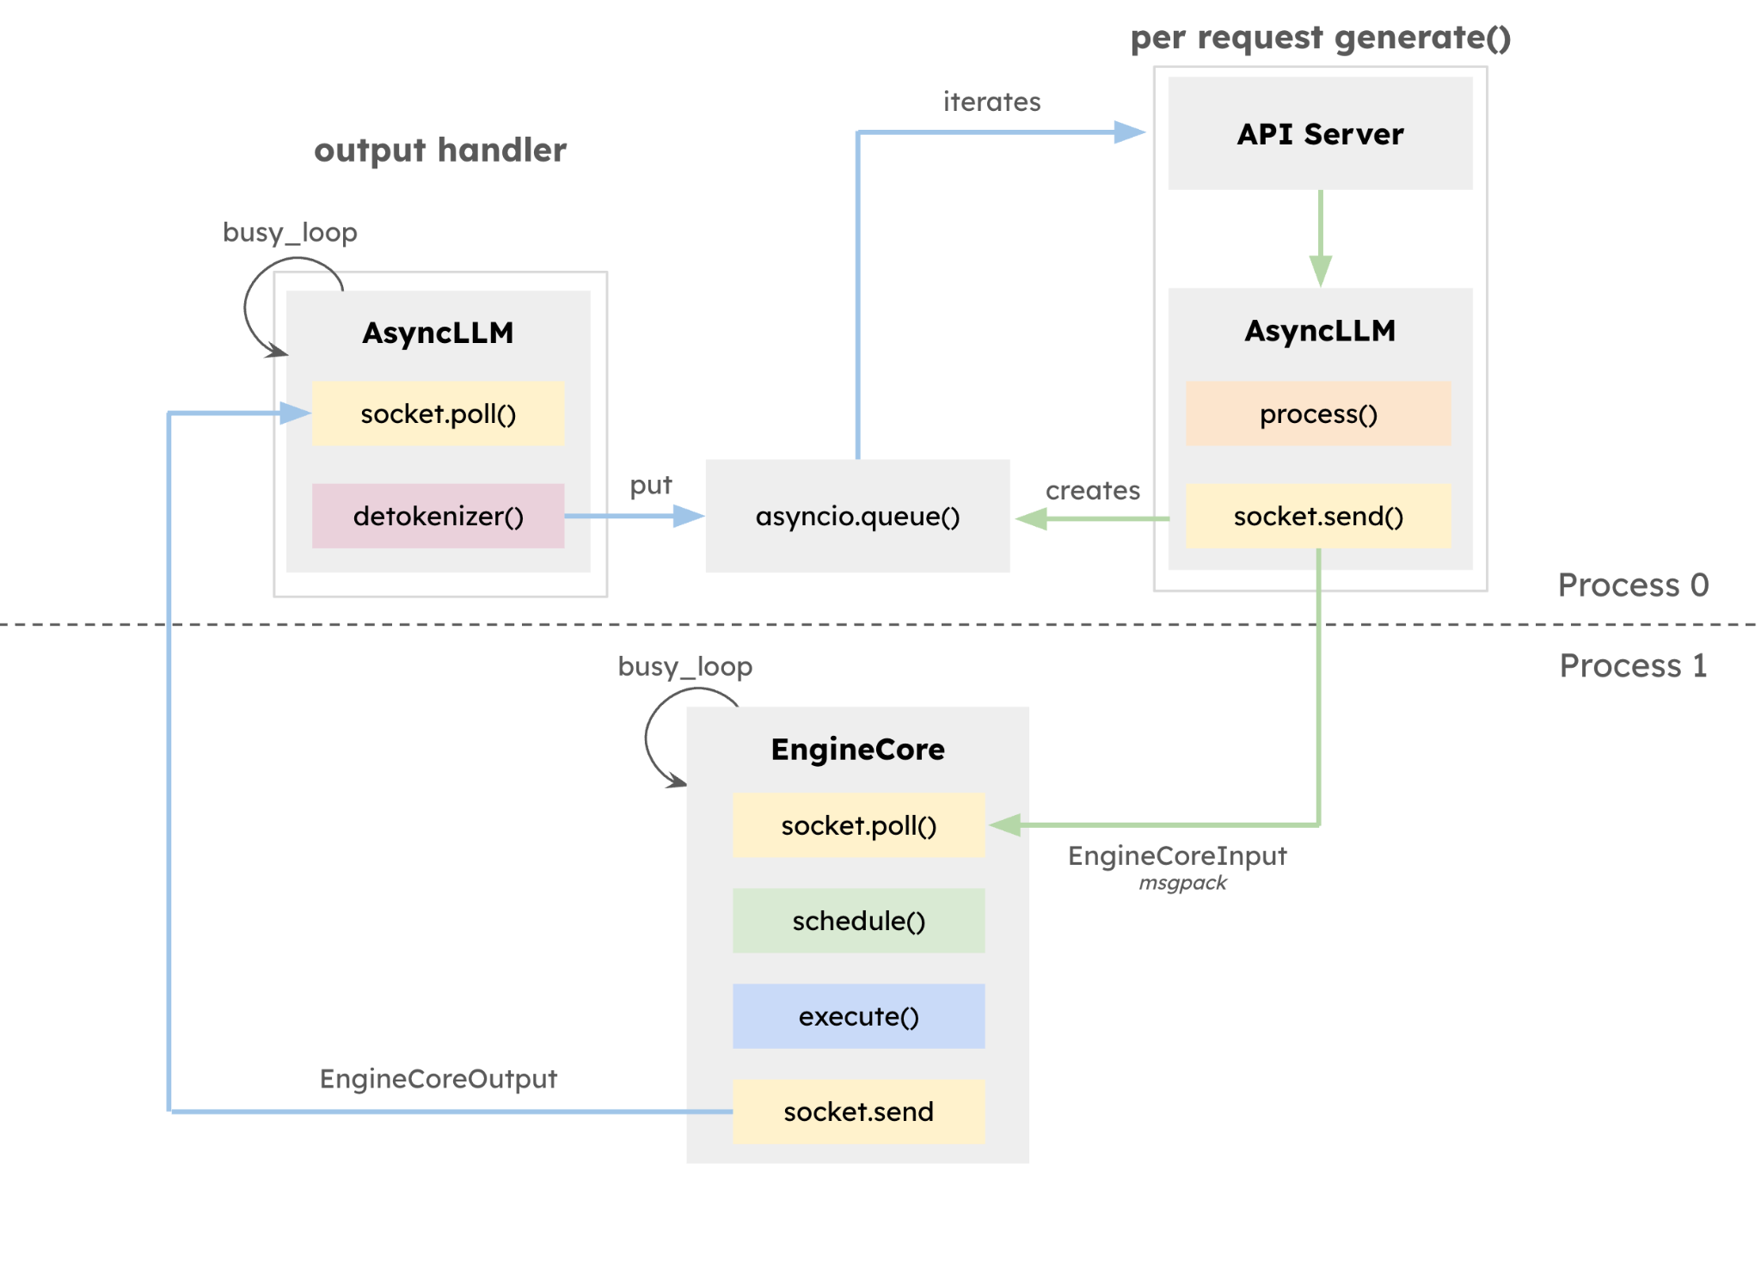
Optimized Engine Loop & API Server (cont’d)
Two-process approach
Process 0 (Frontend): Pre-/post-processing & API Server
Importantly, de-tokenization happens in Process 0
Process 1 (EngineCore): Schedule & execute the model every step
A busy loop that is NOT blocked by Process 0

Slide 13
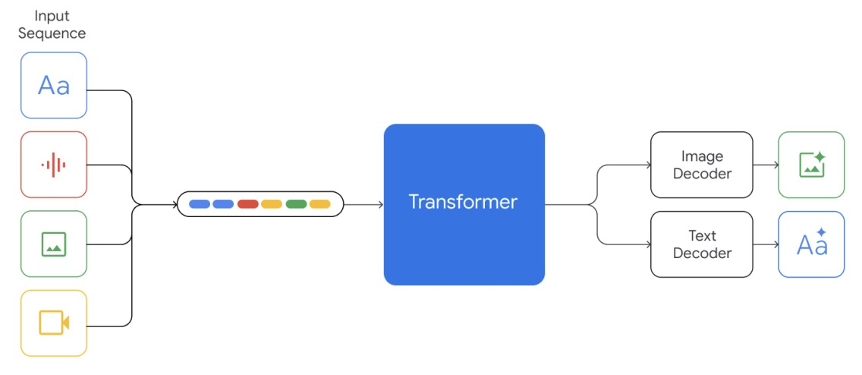
Optimized Engine Loop & API Server (cont’d 2)
We are not there yet!
How to handle emerging modalities such as videos and audios?
It would be increasingly difficult to build a fast & reliable server
We would like to solicit for more community engagement & contributions

Slide 14
Simplified Scheduler
Synchronous single-step scheduler
Chunked prefills (aka Dynamic SplitFuse) by default
The scheduling decision is simply represented as a dictionary of {request_id: num_tokens}
R1
R2
Prompts
R3
Token budget (10)
Scheduler Output
{request: num_tokens}
Step 0
{R1: 3, R2: 5, R3: 2}
Step 1
{R1: 1, R2: 1, R3: 8}
Step 2
{R1: 1, R2: 1, R3: 2}
Step 3
{R1: 1, R2: 1, R3: 1}

Slide 15
Simplified Scheduler (cont’d)
Unification of “prefill” and “decode”
In V1, there’s no concept of prefill and decode
Schedule based on the difference between num_compute_tokens and len(all_token_ids)
Ex1) “Prefill” & “Decode”
num_computed_tokens: 0
all_token_ids
AI | is | the | future | of
Schedule 5 tokens (“prefill”)
num_computed_tokens: 5
AI | is | the | future | of
tech
all_token_ids
Schedule 1 token (“decode”)

Slide 16
Simplified Scheduler (cont’d)
Unification of “prefill” and “decode”
In V1, there’s no concept of prefill and decode
Schedule based on the difference between num_compute_tokens and len(all_token_ids)
Ex2) Chunked prefills
num_computed_tokens: 0
all_token_ids
AI | is | the | future | of
Schedule 3 tokens out of 5
num_computed_tokens: 3
AI | is | the | future | of
all_token_ids
Schedule 2 tokens

Slide 17
Simplified Scheduler (cont’d)
Unification of “prefill” and “decode”
In V1, there’s no concept of prefill and decode
Schedule based on the difference between num_compute_tokens and len(all_token_ids)
Ex3) Prefix caching
num_computed_tokens: 2
all_token_ids
AI | is | the | future | of
Cache hit!
Schedule 3 tokens

Slide 18
Simplified Scheduler: Next Steps
Current: First-come-first-served policy is baked in the scheduler
Next step 1: Support various scheduling policies
Priority-based scheduling
Fair scheduling
Predictive scheduling
Next step 2: Pluggable scheduler
E.g., workload-specific scheduler
E.g., different schedulers for different hardware backends

Slide 19
Clean Implementation of Distributed Inference
V0 Architecture
Scheduler (Proc 0)
Worker 0 (Proc 0)
Worker N-1 (Proc N-1)
Input Prep.
. . .
Broadcast
Model
Model
Sampler

Slide 20
Clean Implementation of Distributed Inference
V0 Architecture
Problem 1: Broadcasting whole input tensors every step
Significant communication overheads
Scheduler (Proc 0)
Worker 0 (Proc 0)
Worker N-1 (Proc N-1)
Input Prep.
. . .
Broadcast
Model
Model
Sampler

Slide 21
Clean Implementation of Distributed Inference
V0 Architecture
Problem 1: Broadcasting whole input tensors every step
Significant communication overheads
Problem 2: Scheduler and Worker 0 share the same process
Increased complexity due to the asymmetric architecture
Scheduler (Proc 0)
Worker 0 (Proc 0)
Worker N-1 (Proc N-1)
Input Prep.
. . .
Broadcast
Model
Model
Sampler

Slide 22
Clean Implementation of Distributed Inference
V0 Architecture
V1 Architecture
Scheduler (Proc 0)
Scheduler (Proc 0)
Broadcast
Worker 0 (Proc 0)
Worker N-1 (Proc N-1)
Worker 0 (Proc 1)
Worker N-1 (Proc N)
Input Prep.
. . .
Input Prep.
. . .
Input Prep.
Broadcast
Model
Model
Model
Model
Sampler
Sampler
Sampler

Slide 23
Clean Implementation of Distributed Inference
Broadcasting the scheduler outputs (Python data structures)
Key optimization: Only sending the diff every step by caching the request states in the worker
Symmetric architecture
Each worker has its own process
No code divergence between worker 0 and other workers
Overall, most of the code for distributed inference is abstracted away
V1 Architecture
Scheduler (Proc 0)
Broadcast
Worker 0 (Proc 1)
Worker N-1 (Proc N)
Input Prep.
. . .
Input Prep.
Model
Model
Sampler
Sampler

Slide 24
Piecewise CUDA Graphs
Q
K
V
V0: Single CUDA graph for the entire model
Pros: Minimal CPU overheads in model execution
Cons: Limited flexibility
Static shapes are required
No CPU operations are allowed
→ Increased development burden
MLP 1
MLP 0
O
Attention
Q
K
V

Slide 25
Piecewise CUDA Graphs (cont’d)
Q
K
V
MLP 1
CUDA graph N
MLP 0
Graph split using torch.compile
O
Attention
PyTorch Eager
Q
K
V
CUDA graph N-1

Slide 26
Piecewise CUDA Graphs (cont’d)
Q
K
V
V1: Splits the model into pieces
Runs the attention op in eager-mode PyTorch
Runs other ops with CUDA graphs
Easy to capture, since the ops are token-wise
Critical to capture the all-reduce op
Pros: Maximum freedom in implementing the attention op
No restriction on shapes
Any CPU operations are allowed
Cons: CPU overheads unhidden by CUDA graphs could slow down the model execution
Negligible for 8B+ models on H100
MLP 1
MLP 0
O
Attention
Q
K
V

Slide 27
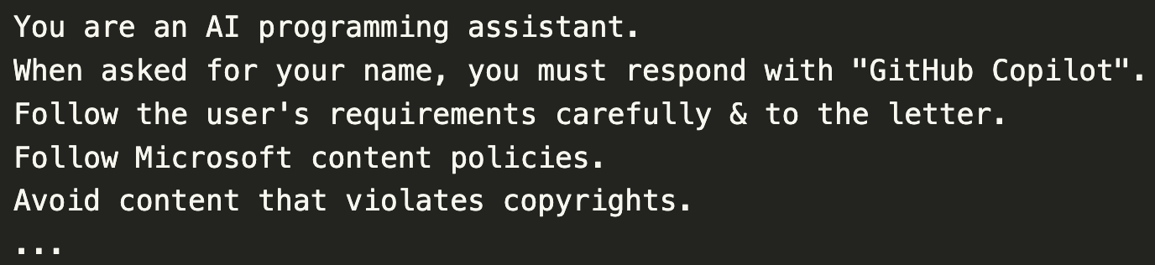
Use Case: Cascade Attention for System Prompts
What is system prompt?
A text prefix describing the task, style, tools, safety rules, etc.
Typically shared for all requests to the model
The length varies a lot by models & applications
E.g., Copilot: ~570 tokens, ChatGPT-4o: ~1200 tokens, Sonnet 3.5: ~2400 tokens

Slide 28
Use Case: Cascade Attention for System Prompts
What is system prompt?
A text prefix describing the task, style, tools, safety rules, etc.
Typically shared for all requests to the model
The length varies a lot by models & applications
E.g., Copilot: ~570 tokens, ChatGPT-4o: ~1200 tokens, Sonnet 3.5: ~2400 tokens
What is cascade attention?
Proposed by Zihao Ye (UW) et al.
A GPU kernel trick to optimize attention with shared KV cache
Was difficult to integrate because the trick makes the kernel more dynamic, making it less compatible with CUDA graph

Slide 29
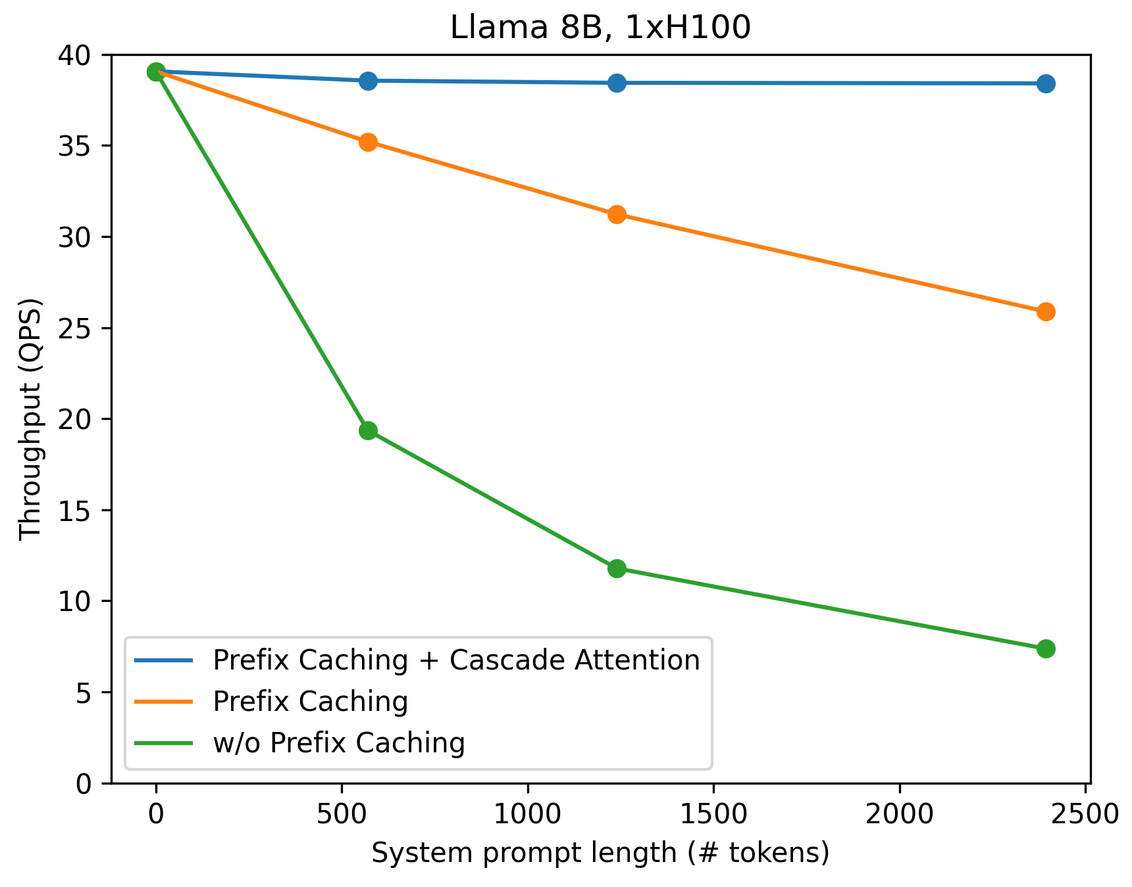
Use Case: Cascade Attention (cont’d)
Thanks to piecewise CUDA graphs, vLLM V1 was able to smoothly integrate cascade attention and enable it by default
Automatically detects the system prompt & applies the optimization
Performance improvements
ShareGPT + system prompts of varying lengths
0–50% throughput increase
Makes the system prompt almost free

Slide 30
Potential Use Cases of Piecewise CUDA Graphs
Piecewise CUDA graphs will allow vLLM to easily integrate new optimizations such as:
KV cache offloading to CPU memory (#11532)
KV cache offloading to disk
Sparse KV cache
Brand-new attention algorithms
. . .

Slide 31
Other Important Enhancements in V1
FlashAttention 3 integration
Also available in V0
Prefix caching for image inputs
Useful for multi-turn chat with images
Miscellaneous Python-level optimizations
Avoid frequently creating new objects
Minimize garbage-collection overhead
. . .

Slide 32
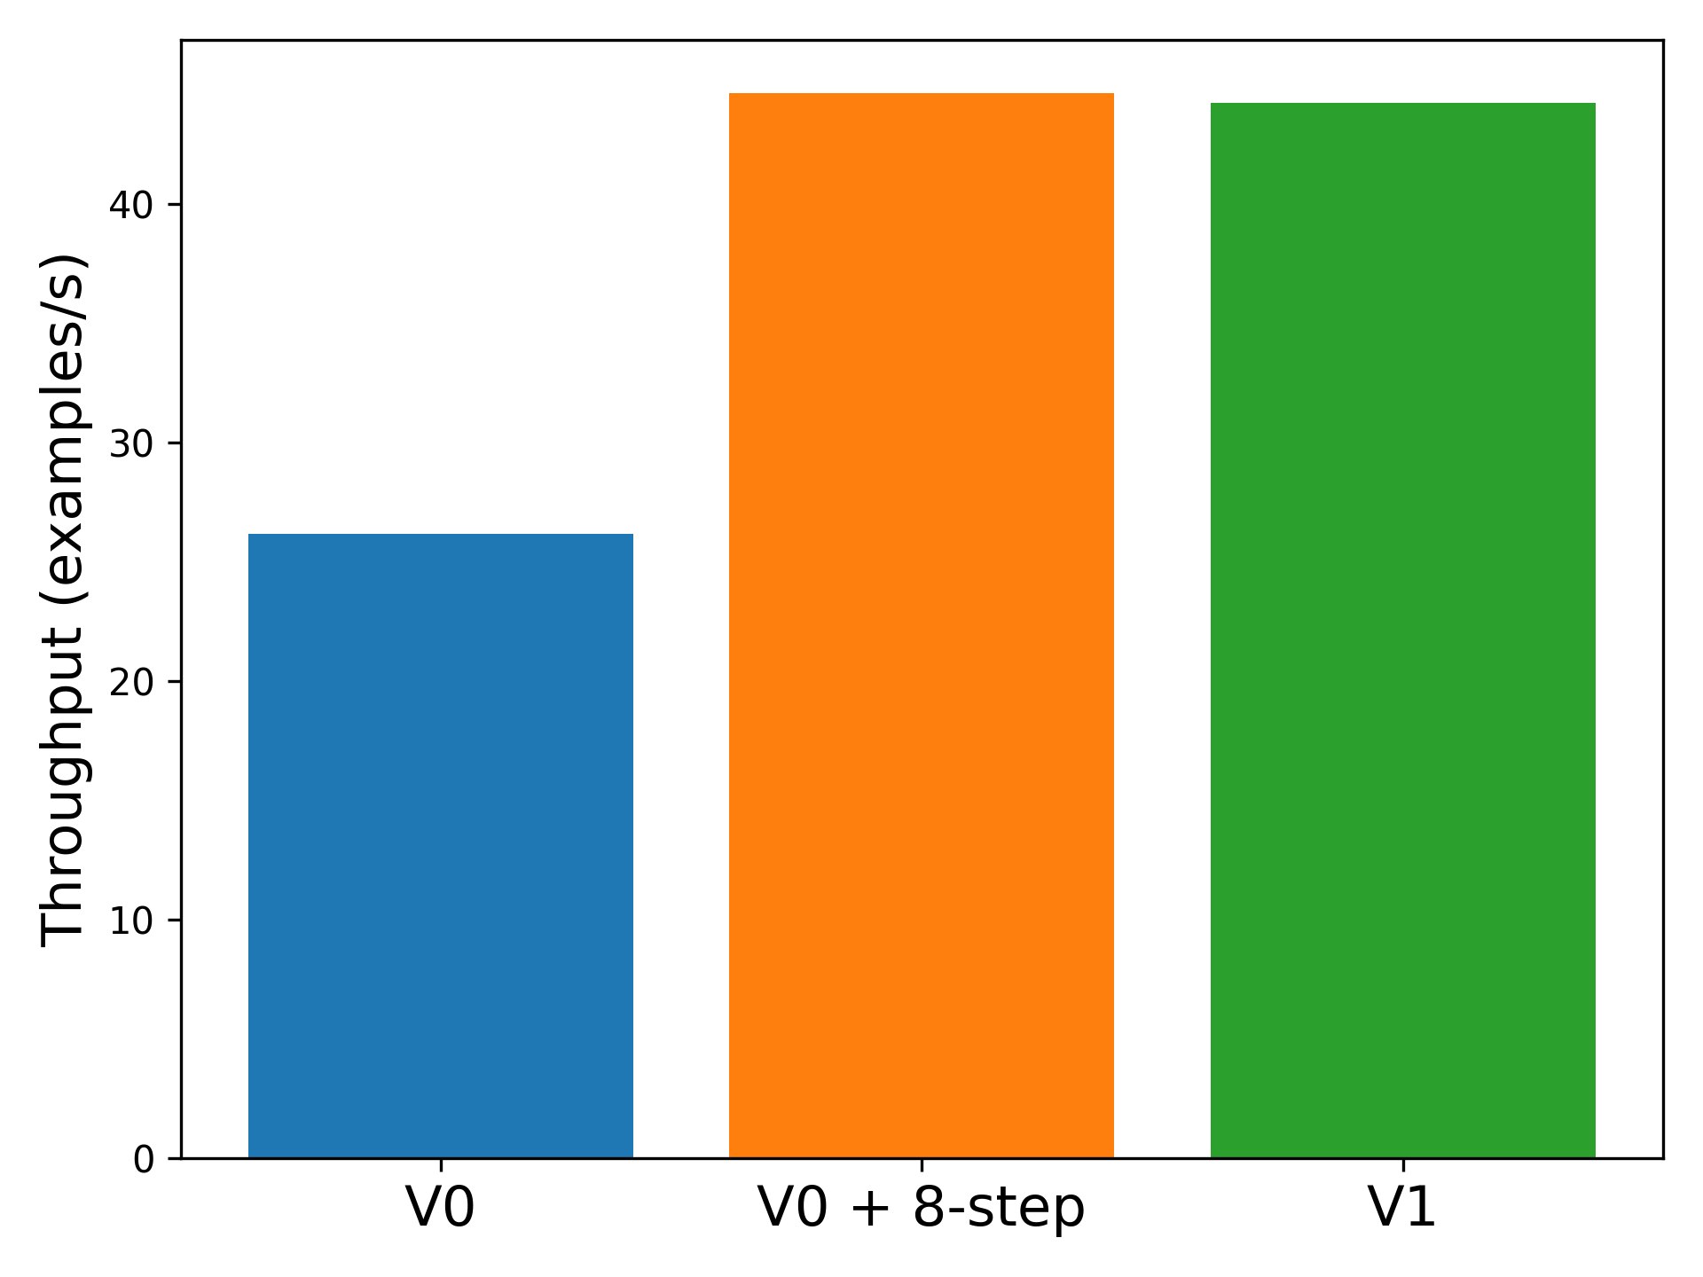
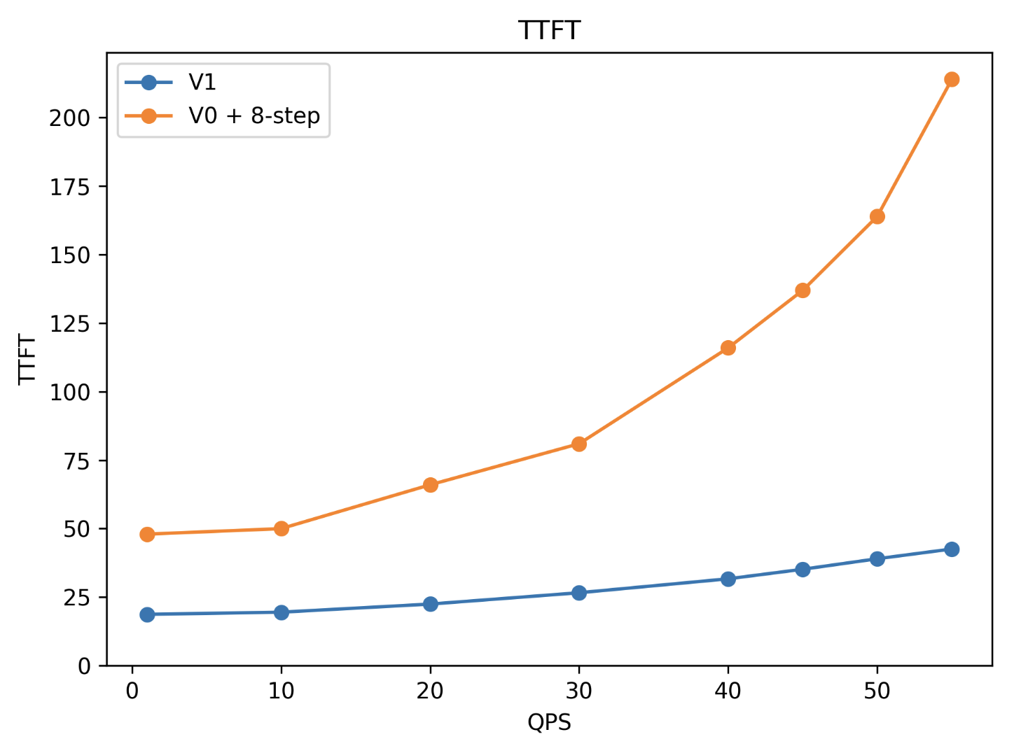
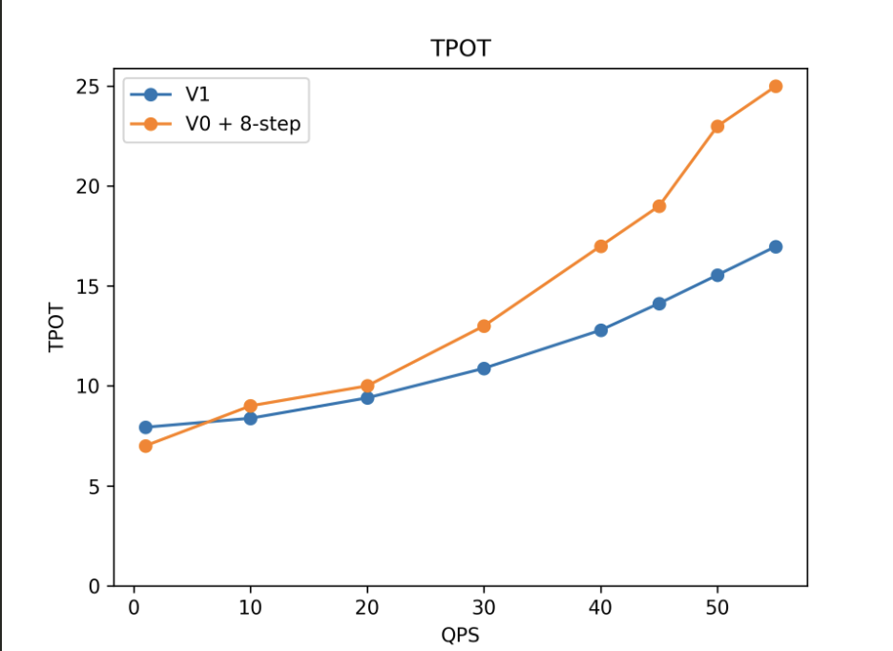
V1 Engine Performance (Llama 3 8B)
Offline Inference
(ShareGPT)
Online Serving
(ShareGPT)
Throughput
Time-to-first-token
Time-per-output-token
Same throughput as V0 + 8-step scheduling
Lower TTFT & TPOT than V0 + 8-step scheduling

Slide 33
V1 Current Status
Will do alpha release very soon
The code can be found in vllm/v1/
Set VLLM_USE_V1=1 to use the V1 engine
Same end-user APIs as V0 (OpenAI server & LLM class)
Supported models
Decoder-only Transformers (e.g., Llama, Mixtral)
Llava-style VLMs (e.g., Pixtral, Qwen2-VL)
Features
Supported: chunked prefills, prefix caching, tensor parallelism
WIP: LoRA, spec decoding, pipeline parallelism, structured outputs
Only supports NVIDIA GPUs for now
Actively working to also integrate other hardware backends

Slide 34
Q1 Roadmap
Simon Mo

Slide 35
vLLM 2025 Vision
Support Emerging Models
Production Deployments
Open Architecture

Slide 36
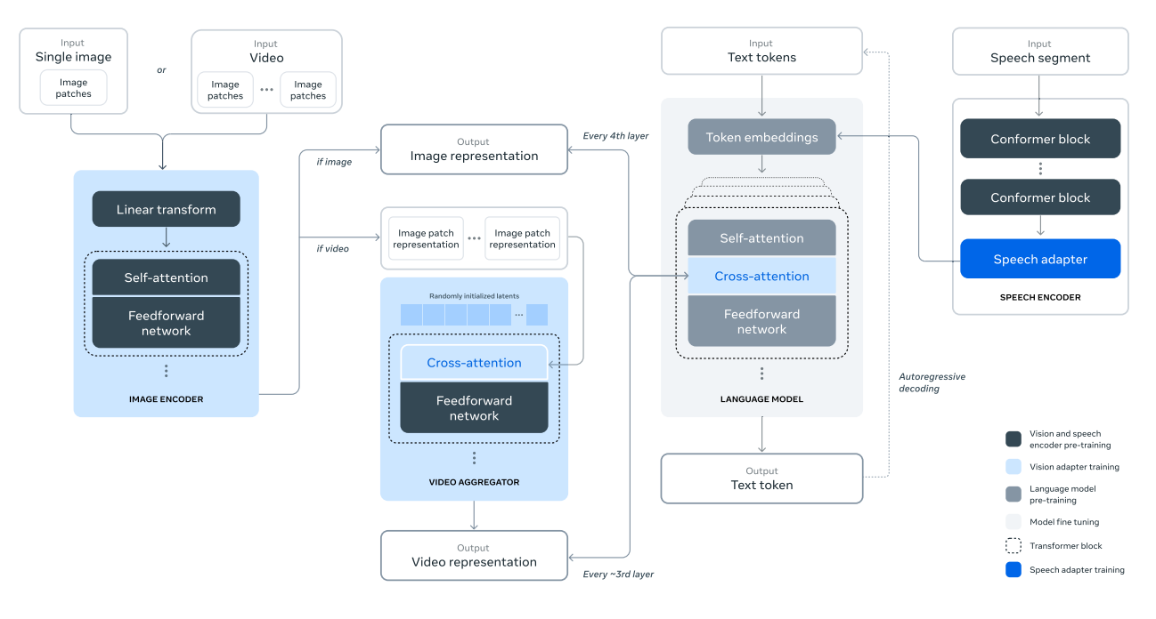
1. Support Emerging Models
…GPT4o level model in 1 GPU, and very large models
Small yet mighty models + large models coexist
System Optimizations for:
KV Cache
MoE
Long Context
Tailored Inference System for:
Reasoning
Coding
Agents
Creative Writing
vLLM being used in data curation and RLHF
Illustration of adding multimodal capabilities to Llama 3

Slide 37
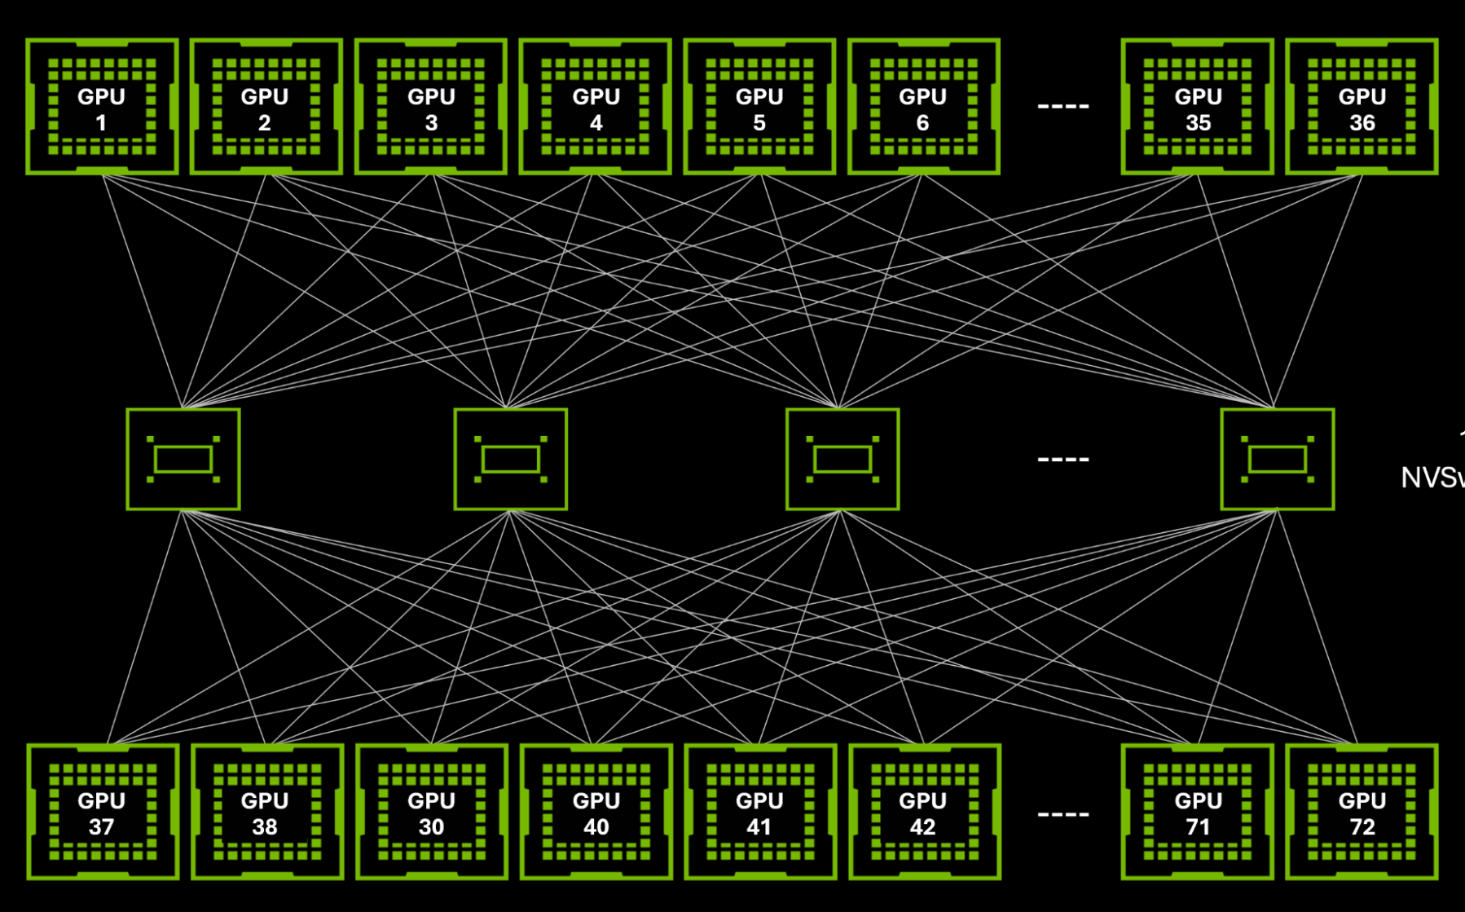
2. Production Deployment
…hundreds of thousands of GPUs scale
The year of productionization of scaled deployments
Recipes and ecosystems for routing, caching, and scaling
High performance by default:
Quantization (< FP8, KV Cache, Attention)
Speculative Decoding
Predicted and Structured Outputs
Cluster solutions increase in importance; support for prefill disaggregation
vLLM being tuned for specific models, leading hardwares, and extreme workloads

Slide 38
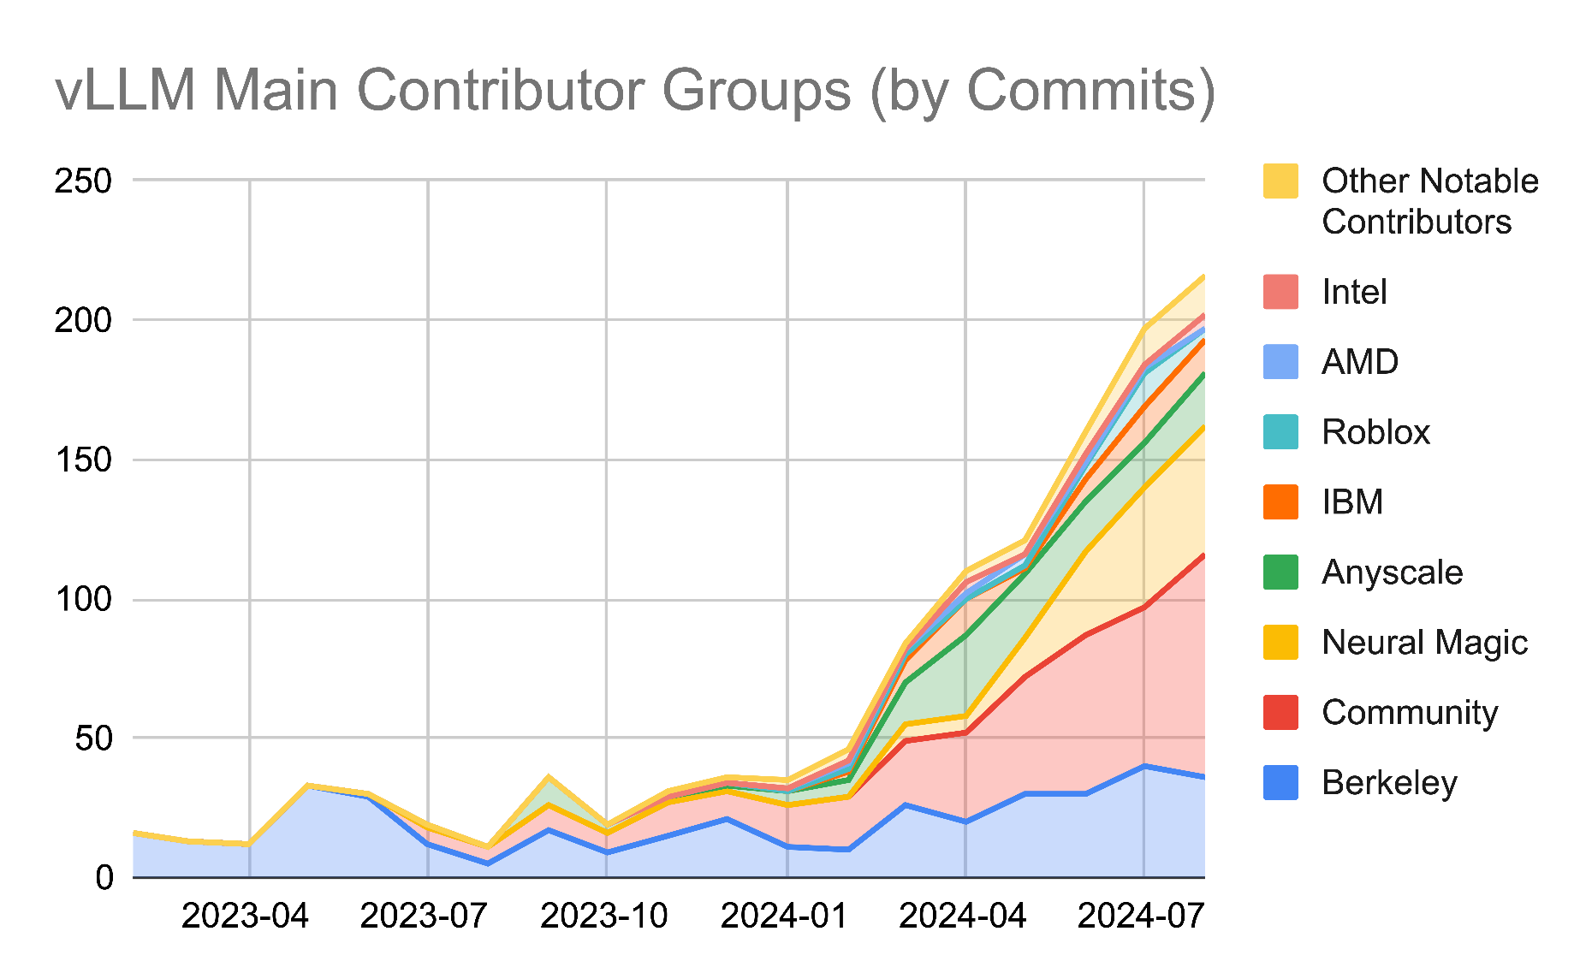
3. Open Architecture is Our Key to Adoption
A community of passionate users, adopters, and contributors
vLLM can be easily extended and modified
Forks and monetization are welcomed
Technically
We will ship a performant yet modular V1 architecture.
torch.compile as an extension point for fusion
Researchers will build on it for new ideas
Users will extend it with private use cases
A coordinated engineering organization spanning multiple companies
A positive ROI for everyone involved

Slide 39
Our Q1 Roadmap
roadmap.vllm.ai
vLLM Core
Emerging Features
Ecosystem Projects

Slide 40
vLLM Core
Ship a performant and modular V1 architecture
V1 on by default, spec decode, hybrid memory allocator and more!
Support large and long context models
Sparsity in attention and MoEs
Disaggregated prefill support
Improved performance in batch mode
RLHF
Long Generation

Slide 41
Built-in RLHF support
If vLLM is an OS,
User requests are normal processes running on the OS
And the OS also provides “system call” to control the behavior of the system
RLHF community has been a key driving-factor for adding new “system calls”, and vLLM has been their primary inference engine
OpenRLHF, veRL, open_instruct, LLaMA-Factory , …
vLLM provides built-in “system calls” that are difficult to implement out-of-tree
Sleep mode: unmap the kv cache and model weights, put vLLM in sleep mode. Give up GPU resource temporarily for training or other models.
RLHF frameworks can also easily customize and add new “system calls”
Provide a new worker class, and use llm.collective_rpc to call the new functions.
For more details, please check the PR.

Slide 42
Features
Model Support
Arbitrary HF model
Alternative checkpoint format
Hardware Support
Blackwell
Improved Tranium/Inferentia, Gaudi
Productionize and support large scale deployment of vLLM on TPU
Out of tree support for IBM Spyre, Ascend, Tenstorrent
Optimizations
AsyncTP/Flux
FlashAttention
Usability
Multi-platform wheels and distributions

Slide 43
Ecosystem Projects
Distributed batch inference
Large scale serving
Prefix aware router
Multi-modality output

Slide 44

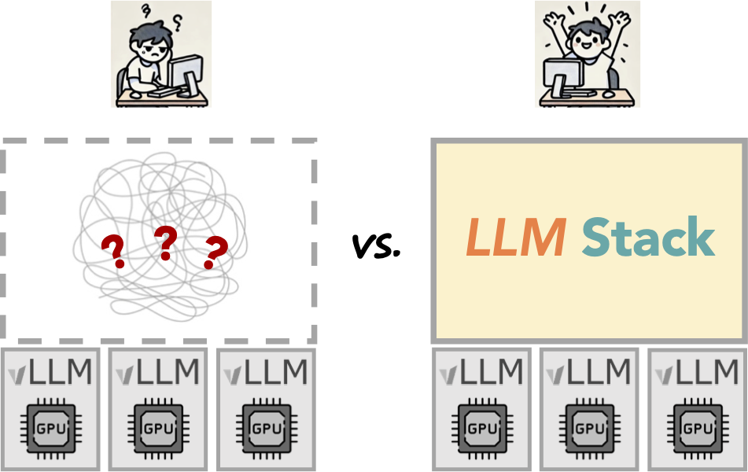
vLLM ecosystem project: LLM inference stack
???
LLM service
A stack on top of vLLM!
LLM

Slide 45
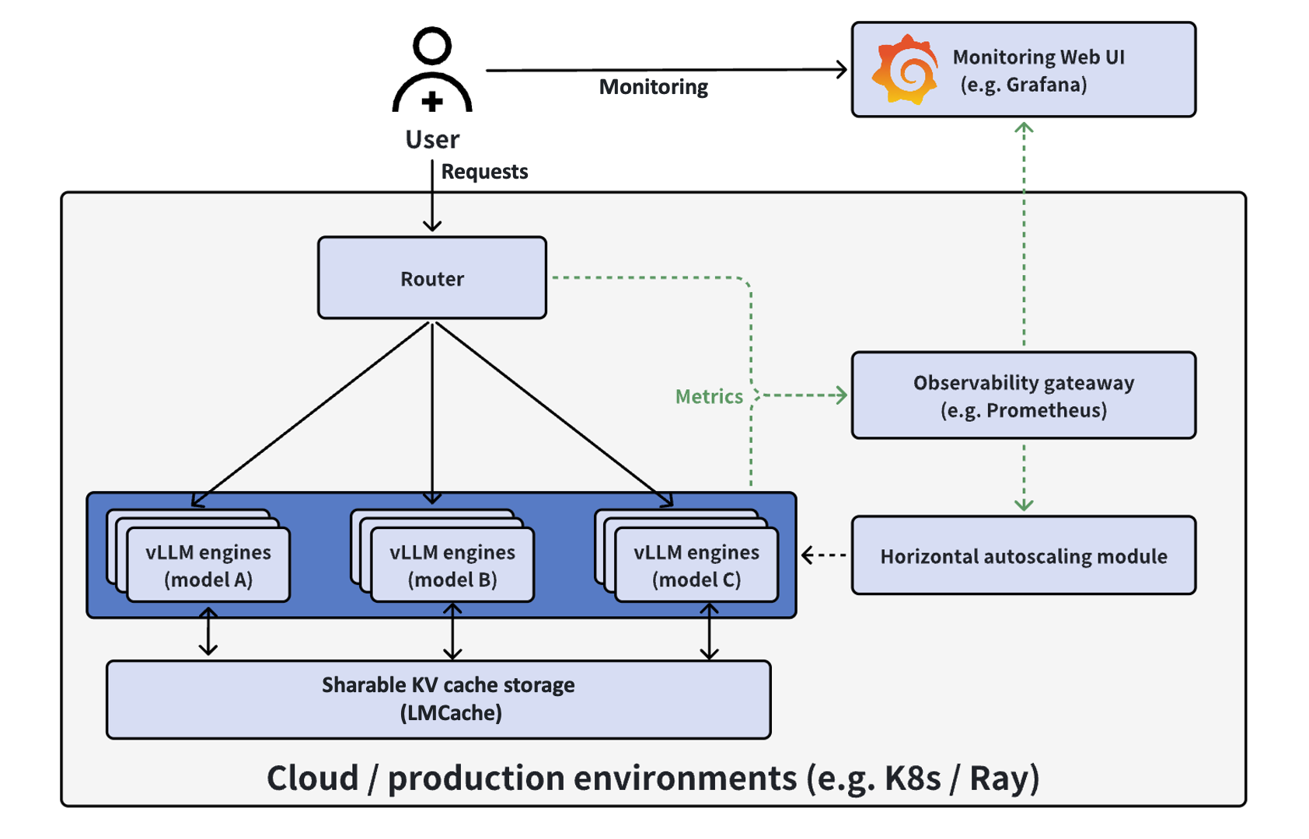
LLMStack:
A Stack on top of

Slide 46
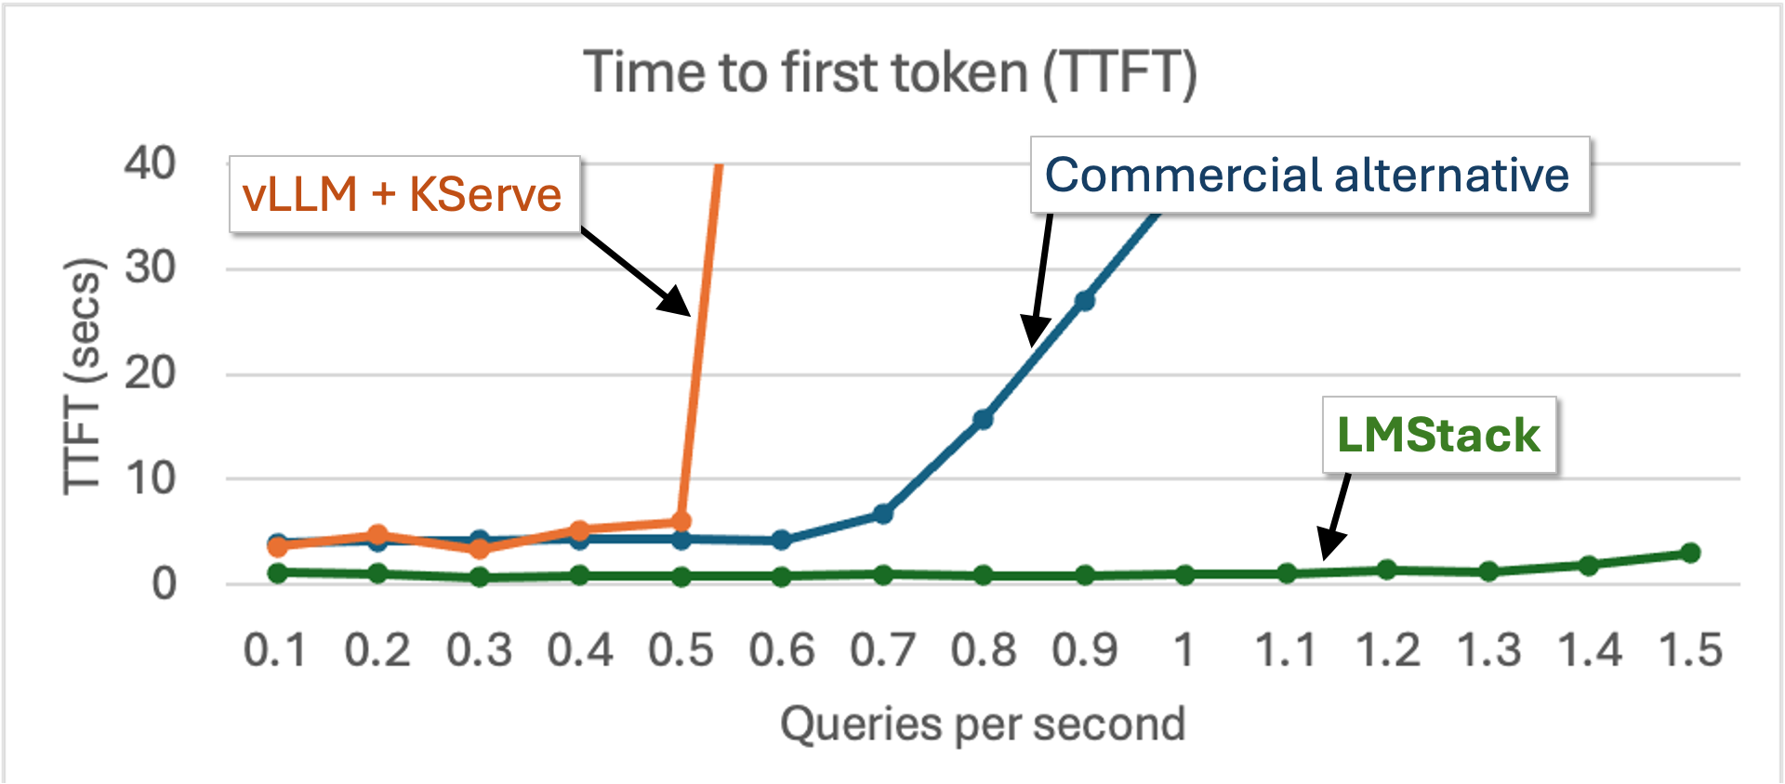
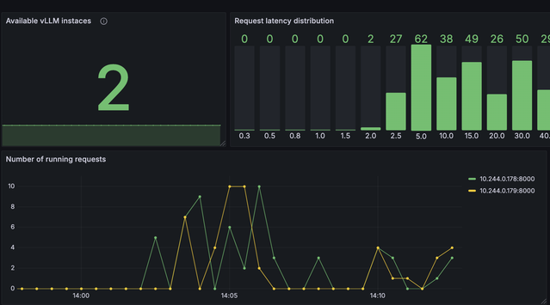
Key features of LLMStack
One-click deployable on kubernetes via helm install
Optimized performance
Smart router & KV cache offloading (LMCache)
Handle 2x more QPS with lower TTFT than commercial alternative!
Cluster-wide observability dashboard

Slide 47






















Thank you sponsors (funding compute!)

Slide 48
Our Goal
Build the fastest and
easiest-to-use open-source
LLM inference & serving engine

Slide 49





Building the fastest and easiest-to-use open-source LLM inference & serving engine!
https://github.com/vllm-project/vllm
https://twitter.com/vllm_project
https://slack.vllm.ai
https://opencollective.com/vllm

